Slide 1
Value/Ethics: Human Impact and Ethics of Data Science

Slide 2
Data Science: Value Domain
Combines the traditional discipline of ethics with the professional activities of business planning, policy making, developing motivations for scientific research, and other activities that have a direct impact on people and the planet.
Key tensions: enterprise vs ethics, private interest vs public good, accuracy vs efficiency, proxy vs original.
Common theme: human value

Slide 3
Main Components of the Field (not complete)
Ethical use of Data/AI and “Bias”– Ethics and Data Science, 97 Things About Ethics Everyone in Data Science Should Know, Weapons of Math Destruction – Interpretative Field
Justice, Diversity, Equity and Inclusion – (JEDI)
Fairness of Machine Learning - Practical Fairness
Human Centered Design - Designing Human-Centric AI Experiences: Applied UX Design for Artificial Intelligence
Interpretable AI - An Introduction to Machine Learning Interpretability, 2nd Edition
Data Policies and Governance – GDPR - https://gdpr.eu/what-is-gdpr/
Notes:
Off these categories which seems to be the most all largest category?

Slide 4


Which do you find the most interesting?
ⓘ Start presenting to display the poll results on this slide.

Slide 5
Data Science Ethical Investigators
Ask:
What went wrong?
How could this be avoided?
Where in the DS Lifecycle did it go wrong?

Slide 6
Data Science Lifecycle of Methods
Pre-processing – Methods that attempt to change the data prior to model building. Example is weighting down data points that are believed to potentially contribute to bias and up others that might be a solution against bias.
In-processing – Generating models with an interpretable approach, instead of simply focusing on accuracy or other measures.
Post-processing – Reviewing the evaluation and determine if the model is producing unfair distributions of predictions – mostly about how the errors are distributed (Fairness).

Slide 7
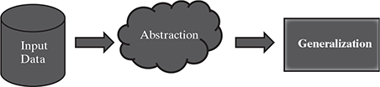
Data == Our Current Knowledge to solve a problem
Abstraction == A Mathematical/Computation Model
Generalization == Prediction – Probability (0-100)

Slide 8
Which of the components covers the most space?
ⓘ Start presenting to display the poll results on this slide.

Slide 9
Ok so lots of data and machine learning/AI but…..
how has the field changed…
….more importantly how?
….more importantly why?

Slide 10
Case Number 1
Ask:
What went wrong?
How could this be avoided?
Where in the DS Lifecycle did it go wrong?

Slide 11
Joy Video and Discussion
How I'm fighting bias in algorithms | Joy Buolamwini
What is going on here, why can’t the software see her face?
Notes:
First Search for Algorithmic Bias, Next AI, then Statistical Bias, lastly change AI to Artificial Intelligence.

Slide 12
Case Number 1
Ask:
What went wrong?
How could this be avoided?
Where in the DS Lifecycle did it go wrong?

Slide 13
Case Number 2
Ask:
What went wrong?
How could this be avoided?
Where in the DS Lifecycle did it go wrong?

Slide 14
Machine Learning Bias and Social Science Methods
YouTube Case Study
In 2021 YouTube crossed a milestone on hours watched per day….guess?
~1 billion!
Equivalent to ~137,000 years, every day!

Slide 15
Machine Learning Bias and Social Science Methods
YouTube
Around 2011-12 switched their model to hours watched from clicks
Brought in Google Brain to train the Deep Neural Network to make the video recommendations
Similar videos got recommended…but often that resulted in gradually getting more and more extreme content, regardless of the topic and a lack of diversity of topics…jogger to ultra marathon or politically leaning to extremist
Why?

Slide 16
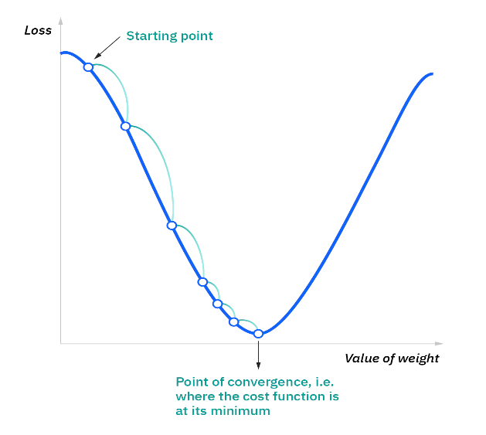
Machine Learning Bias and Social Science Methods
Machine Learning detected the pattern and optimized for it, its that simple.

Slide 17
Case Number 2
Ask:
What went wrong?
How could this be avoided?
Where in the DS Lifecycle did it go wrong?

Slide 18
Ethical Use of Data
Given the previous exercise, think: “code of ethical conduct for data science projects”
What would be the top priority if you were the author?

Slide 19
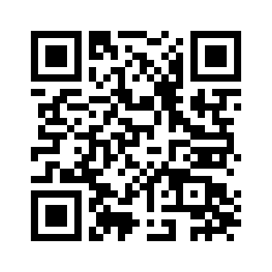
Ethical Use of ML and AI
What does informed consent mean? Skip to Valid Elements section
Do you believe Big Tech/Social Media companies have established your informed consent?
Google Takeout: https://myaccount.google.com/data-and-personalization
Facebook Data Access: https://www.facebook.com/help/131112897028467
TPS
Notes:
Just think to yourself – no sharing -

Slide 20
Big Tent Data Science Ethics
Growing area of concern – that will continue to be important as more data and algos enter our lives
These concerns are present throughout the Data Science Lifecycle
Can have large impacts on Society
Other fields = informed consent is heavily regulated….not as much in Data Science
Important that this topic be embedded in Data Science oriented education

Slide 21
If it was determined that you might have a virus would you allow yourself to be tracked for the greater public good?
Is allowing Google/Facebook to create behavior profiles associated with your search behavior to generated targeted ads/content an acceptable trade off for getting Google products for “free”?
Notes:
Questions we might consider in leading into this discussion…not to be answered but as a frame of reference.

Slide 22
Case Study: Amazon Recruiting Engine
Used an AI tool to give candidates a simple score from one to five stars based on resumes.
“They (Amazon) literally wanted it to be an engine where I’m going to give you 100 resumes, and it will spit out the top five, and we’ll hire those.”
Problem is that the tool systematically scored female candidate resumes lower

Slide 23
Case Number 3
Ask:
What went wrong?
How could this be avoided?
Where in the DS Lifecycle did it go wrong?

Slide 24
Where did Amazon go wrong? What Phase?
Phase 2: Idea Testing
G1
G2
Data Acquisition
Data Understanding - EDA
Initial Model(s) Building
Initial Model
Evaluation
Model Creation & Training
Evaluation Criteria Value Metric
Feature Engineering and Evaluation
Phase 1: Idea Development
Model Deployment
Final Model Evaluation Testing and Preparation for Deployment
Business Understanding
Data Drift Analysis
Model Performance – Evaluation Value Metric
G3
Question ID
Phase 3: Solution Development
Model Drift Analysis – Model Evaluation
Gate Reviews
Reports – Dashboards - Products
Phase 4: Solution Deployment
TPS

Slide 25
Think about the YouTube case, what could have been done differently to avoid the creation of crazy rabbit holes.
Which phase does your recommendation fall into?
Phase 2: Idea Testing
G1
G2
Data Acquisition
Data Understanding - EDA
Initial Model(s) Building
Initial Model
Evaluation
Model Creation & Training
Evaluation Criteria Value Metric
Feature Engineering and Evaluation
Phase 1: Idea Development
Model Deployment
Final Model Evaluation Testing and Preparation for Deployment
Business Understanding
Data Drift Analysis
Model Performance – Evaluation Value Metric
G3
Question ID
Phase 3: Solution Development
Model Drift Analysis – Model Evaluation
Gate Reviews
Reports – Dashboards - Products
Phase 4: Solution Deployment
Notes:
Where did most of the issues generate from which phase…dots on the screen

Slide 26
Main Components of the Field (not complete)
Ethical use of Data/AI and “Bias”– Ethics and Data Science, 97 Things About Ethics Everyone in Data Science Should Know, Weapons of Math Destruction
Justice, Diversity, Equity and Inclusion – (JEDI)
Fairness of Machine Learning - Practical Fairness
Human Centered Design - Designing Human-Centric AI Experiences: Applied UX Design for Artificial Intelligence
Interpretable AI - An Introduction to Machine Learning Interpretability, 2nd Edition
Data Policies and Governance – GDPR - https://gdpr.eu/what-is-gdpr/
Notes:
Off these categories which seems to be the most all largest category?

Slide 27
Definitions of an Evolving Field: “Bias”

Slide 28
What does Machine Learning/AI Bias mean?
The term “bias” as it applies to machine learning was introduced by Tom Mitchell in 1980.
Suggested bias is a necessity to generalize results but also says…
“any basis for choosing one generalization (hypothesis) over another, other than strict consistency with the observed training instances”
Seems to speak to intended conscious bias, knowing what the results suggest but acting differently.

Slide 29
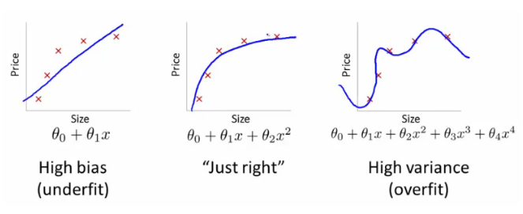
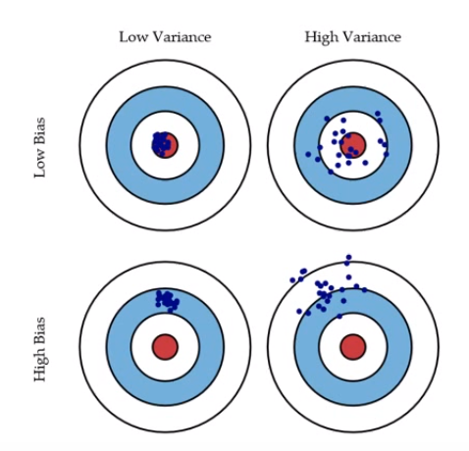
Bias Versus Variance

Slide 30
What does Machine Learning/AI Bias mean?
Current dialogue around AI Bias doesn’t speak to what is commonly referred to as statistical bias (Mitchell’s first point) or intentional bias (Mitchell’s second point.
Instead the definition centers on cognitive bias or societal bias that gets replicated into data and trained in machine learning or AI algos.
From our friends at Wiki:
“…systematic and repeatable errors in a computer system that create unfair outcomes…, including but not limited to the design of the algorithm or the unintended or unanticipated use or decisions relating to the way data is coded, collected, selected or used to train the algorithm.
…this eludes to another, Bias when Engineering ML Models

Slide 31
This gives us with several forms of “bias” (not mutually exclusive):
Statistical Bias – Mathematically necessary to generalize outcomes to new examples (bias/variance tradeoff)
Conscious Bias – Bad actors
Cognitive Bias – Behavioral economics - humans do not make rational decision but are instead influenced by their environments. Replicated into datasets and learned by models. ²
Perceptual distortion, bad judgement, illogical interpretation or simply acting irrational.
Engineering of ML Bias – Building of the machines that are flawed; model selection, sampling error, evaluation bias, aggregate bias…etc. See Survey on Machine Learning Bias by MEHRABI, MORSTATTER, SAXENA, LERMAN, and GALSTYAN, retrieved from: https://arxiv.org/pdf/1908.09635.pdf for more information on types of bias.
Kahneman, D.; Tversky, A. (1972). "Subjective probability: A judgment of representativeness". Cognitive Psychology.

Slide 32
Data is also a huge issue…maybe the largest and least discussed.
“GIGO”
Noisy Datasets
Lack of samples (small n)
Imbalanced Datasets
Mislabeled or Misleading or Missing
Curse of Dimensionality
What else?
TPS

Slide 33





This gives us with several forms of “bias” (not mutually exclusive):
Statistical Bias
Conscious Bias
Cognitive Bias
Engineering of ML Bias
GIGO

Slide 34
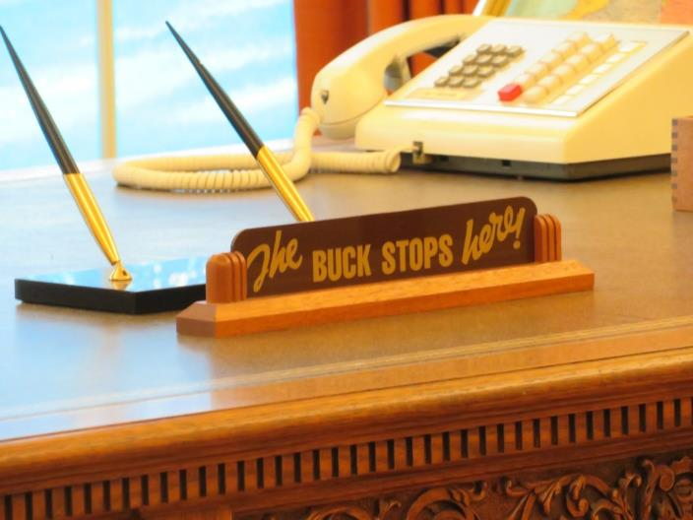
Key point: Humans are the source of 99% of these issues, not the data or the models.
This Photo by Unknown Author is licensed under CC BY-SA
Notes:
Harry Truman: https://www.trumanlibrary.gov/education/trivia/buck-stops-here-sign

Slide 35
Framework for “Bias” in the Wild
as presented by
Weapons of Math Destruction
by
Cathy O’Neil

Slide 36
Characteristics of WMDs
Even in cases where awareness of the model is present it still cannot be understood, purposely opaque.
Do the models work against human interest.
Is a reinforcement loop present in the algo, such that new information is not being incorporate.
Has the model scaled to affect larger and larger numbers.
Notes:
Between those that develop the IP and to whom the IP effects….

Slide 37
Characteristics of WMDs
2. Does the model work against human interest, is it fair?
If bias or unfairness is present its likely only to become more entrenched as the model continues to mature.
Analogy: Nature versus Nurture
Bias models are created (data scientists) and as such can be born bad. Meaning they will only likely continue to get worse over time (at best level out).
Once a set of processes have been machine coded and put into production there’s limited opportunity for nurturing to truly help.
Can we design a process that allows for the Nature of Machine Learning Algorithms to be positive?

Slide 38
Most of the current dialogue (types of bias) and the examples we are about to work through apply to issue number 2 and the cognitive bias category of the four general types of bias…
…algorithms working against human interest or FAIRNESS of Machine Learning

Slide 39
That was, types of biases and a framework for models gone bad…let’s pause for a moment
Let’s discuss manifestations in the real world and how we measure “bias” quantitively
Moves us into the field of Fairness

Slide 40
Main Components of the Field (not complete)
Ethical use of Data/AI and “Bias”– Ethics and Data Science, 97 Things About Ethics Everyone in Data Science Should Know, Weapons of Math Destruction – Interpretative Field
Justice, Diversity, Equity and Inclusion – (JEDI)
Fairness of Machine Learning - Practical Fairness
Human Centered Design - Designing Human-Centric AI Experiences: Applied UX Design for Artificial Intelligence
Interpretable AI - An Introduction to Machine Learning Interpretability, 2nd Edition
Data Policies and Governance – GDPR - https://gdpr.eu/what-is-gdpr/
Notes:
Off these categories which seems to be the most all largest category?

Slide 41
To a certain extent we can never eliminate the human/cognitive bias present in our society, therefore training data may always be corrupt.
Until a time in which machine learning improves to the point that these biases can be accounted for we need to make thoughtful decisions about how we use these tools, lucky some techniques are emerging.

Slide 42
Data Science Lifecycle of Methods
Pre-processing – Methods that attempt to change the data prior to model building. Example is weighting down data points that are believed to potentially contribute to bias and up others that might be a solution against bias.
In-processing – Generating models with an interpretable approach, instead of simply focusing on accuracy or other measures.
Post-processing – Reviewing the evaluation and determine if the model is producing unfair distributions of predictions – mostly about how the errors are distributed (Fairness).

Slide 43
Post-Processing Fairness – The field is starting to mature around some central approaches to assessing fairness of machine learning algorithms
Fairness (non-bias) - outcomes of a machine learning can be mathematically proven to treat the protected classes equally
Meaning the errors of a model are similar across these groups. These groups usually represent “protected classes” such as gender or race or sexual orientation.
Keep in mind that there may be statistical variations in outcomes between these groups already, what we want is the model to take these into account but not unfairly penalize the protected class variables in comparison to those that have similar profiles that don’t represent a protected class – individual fairness

Slide 44
Machine Learning Bias and Social Science Methods
In assessing whether our models are “fair” we can use several rather simple assessment approaches
Demographic Parity
Equality of Odds
Equality of Opportunity
But…before we dig into these, we need to discuss evaluations of ML models, specifically confusion matrices and AUC/ROC curves…maybe

Slide 45
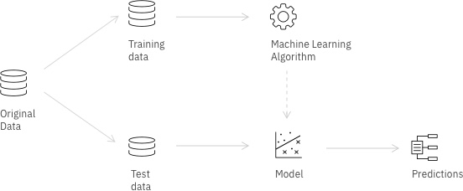
Source: https://nbviewer.org/github/IBM/AIF360/blob/master/examples/tutorial_credit_scoring.ipynb

Slide 46
Threshold of .50
The Target Variable of Interest has 2 levels: 0 and 1
Threshold of .75
Index | Predicted Probability | Prediction
1 | .50 | 1
2 | .75 | 1
3 | .25 | 0
4 | .35 | 0
5 | .45 | 0
6 | .70 | 1
7 | .76 | 1
Index | Predicted Probability | Prediction
1 | .50
2 | .75
3 | .25
4 | .35
5 | .45
6 | .70
7 | .76

Slide 47
Machine Learning Bias and Social Science Methods
Email Spam Predictor
Below are results of a model in a Confusion Matrix. They center on the positive and negative classifications in sub-categories of true and false positive.
Keep in mind we know because of the labels, what is fraud and not, so we can measure how good the model is classifying.
Both true negative and true positive are good, false negative and false positive are errors.
1 = Fraud/Spam 0 = Not Fraud/Spam |  | Predicted Class
 |  | Positive Fraud Pred (1) | Negative Not Fraud Pred (0)
Actual Class | Positive Fraud Actual (1) | True Positive 10 | False Negatives 22
 | Negative Not Fraud Actual (0) | False Positives 7 | True Negative 96

Slide 48
Machine Learning Bias and Social Science Methods
Let’s consider the extremes: what if we set the threshold to 0?
Means that everything is captured as Fraud and no ever gets an email again!
1 = Fraud/Spam 0 = Not Fraud/Spam |  | Predicted Class
 |  | Positive Fraud Pred (1) | Negative Not Fraud Pred (0)
Actual Class | Positive Fraud Actual (1) | True Positive 32 | False Negatives 0
 | Negative Not Fraud Actual (0) | False Positives 103 | True Negative 0

Slide 49
Machine Learning Bias and Social Science Methods
Let’s consider the other extreme: what if we set the threshold to 100?
Means nothing is fraud and now everyone is getting rich off of Arabian princes
1 = Fraud/Spam 0 = Not Fraud/Spam |  | Predicted Class
 |  | Positive Fraud Pred (1) | Negative Not Fraud Pred (0)
Actual Class | Positive Fraud Actual (1) | True Positive 0 | False Negatives 32
 | Negative Not Fraud Actual (0) | False Positives 0 | True Negative 103

Slide 50
Machine Learning Bias and Social Science Methods
We can further assess our model by generating classification rates:
True Positive Rate (TPR) (Sensitivity) = TP/(TP+FN) = 10/(10+22) = .31
% of fraud correctly labeled as fraud
False Positive Rate (FPR) (1- Specificity) = FP/(FP+TN) = 7/(7+96) = .06
% of emails labelled not fraud that were false positives
1 = Fraud/Spam 0 = Not Fraud/Spam |  | Predicted Class
 |  | Positive Fraud Pred (1) | Negative Not Fraud Pred (0)
Actual Class | Positive Fraud Actual (1) | True Positive 10 | False Negatives 22
 | Negative Not Fraud Actual (0) | False Positives 7 | True Negative 96

Slide 51
Machine Learning Bias and Social Science Methods
These two data points can used to begin to develop a Receiver Operating Characteristic Curve or ROC curve
True Positive Rate (TPR) = 10/(10+22) = .31 = y-axis
False Positive Rate (FPR) = 7/(7+96) = .06 = x-axis
1 = Fraud/Spam 0 = Not Fraud/Spam |  | Predicted Class
 |  | Positive Fraud Pred (1) | Negative Not Fraud Pred (0)
Actual Class | Positive Fraud Actual (1) | True Positive 10 | False Negatives 22
 | Negative Not Fraud Actual (0) | False Positives 7 | True Negative 96

Slide 52
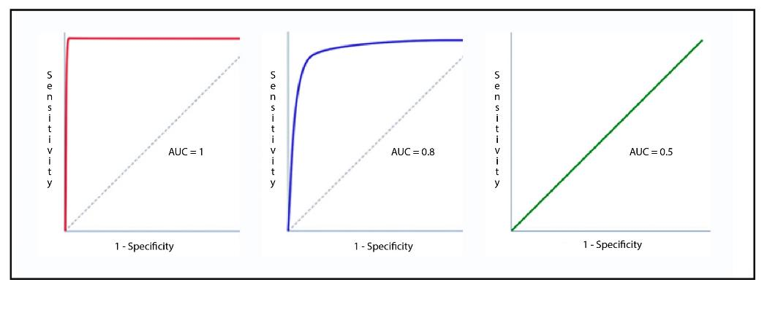
Machine Learning Bias and Social Science Methods
ROC curve generates the area under the curve as a percentage of the total graph under the curve.

Slide 53
Computational Example

Slide 54
Machine Learning Bias and Fairness
Demographic (proportional) Parity – Works to determine if each of the sub-groups (protected classes) have the same proportion in the positive category.
As an example, assume we develop a model of assessing worthiness for getting a loan. If the same relative percentages of all race in the model, everything else being equal, were approved for a loan this condition would be satisfied.
However, this is not overly useful. It’s basically over simplified and could limit our ability to understand more discrete issues with the performance of the model.

Slide 55
Machine Learning Bias and Fairness
Equality of Odds– Works to determine if predictions are conditional independent from the protected class. Sensitivity – TP/TP + FN
It is a measure of if the true positive rate and false positive rate are the same for the various protected classes across different threshold levels.
This is basically ROCs for each of the sub-groups. How well does the model preform if the class are broken apart and analyzed.
Below A is the protected class with a binary classifier, for this to be true the odds of being placed in either 0 or 1 should be independent of A.
1
¹ Hardit, M, Price, E, & Srebro, N. (2016). Equality of Opportunity in Supervised Learning. NIPS, Barcelona, Spain.

Slide 56
Machine Learning Bias and Fairness
Equal Opportunity– Extension of Equality of Odds but only focuses on the positive attribute, typically the classifier of 1 in the binary case. (R – Predicted Rate Parity)
Precision – TP/TP+FP
We want the true positive rate to be the same for each protected class
Below A is the protected class with a binary classifier, for this to be true the odds of being classified as 1 should be independent of A.
¹ Hardit, M, Price, E, & Srebro, N. (2016). Equality of Opportunity in Supervised Learning. NIPS, Barcelona, Spain.

Slide 57
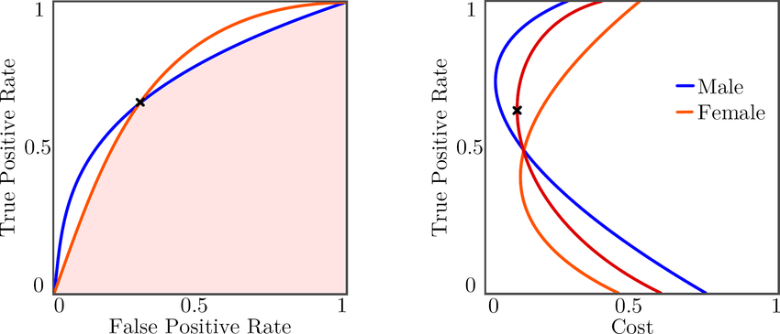
Machine Learning Bias and Fairness
The idea behind these methods is to find the ideal threshold that allows the equations to be satisfied.
¹ Hardit, M, Price, E, & Srebro, N. (2016). Equality of Opportunity in Supervised Learning. NIPS, Barcelona, Spain.

Slide 58
Machine Learning Bias and Fairness
Threshold shift to satisfy any of these conditions can be difficult and sometimes not feasible given the data at hand.
Often, we can control for these differences prior to developing our algorithms through more complicated methods that work to balance the differences between classes.
You can think of these as methods weighting the variables ahead of time to avoid any potential bias.
R Example ….Maybe

Slide 59
Updates and Last Week?

Slide 60
“Explainable AI” and Trust
(Break)

Slide 61
Starts with Trust

Slide 62

How Trust is Represented in Human Computer Interface
User's level of trust in technology can influence how they use that technology and is largely predicated on performance metrics (Bagheri and Jamieson, 2004; Lee and Moray, 1994; Muir, 1987).
Over trust of technology often results in misuse of technology that leads to complications and errors in the work system. (Xu, Le, Deitermann, & Montague, 2014)
On the other hand, lack of trust in technology prevents the user from utilizing the system to its full extent and can lead to a decrease in productivity. (Xu, Le, Deitermann, & Montague, 2014)
How do we find this comfortable equilibrium that results in a healthy awareness or healthy distrust

Slide 63
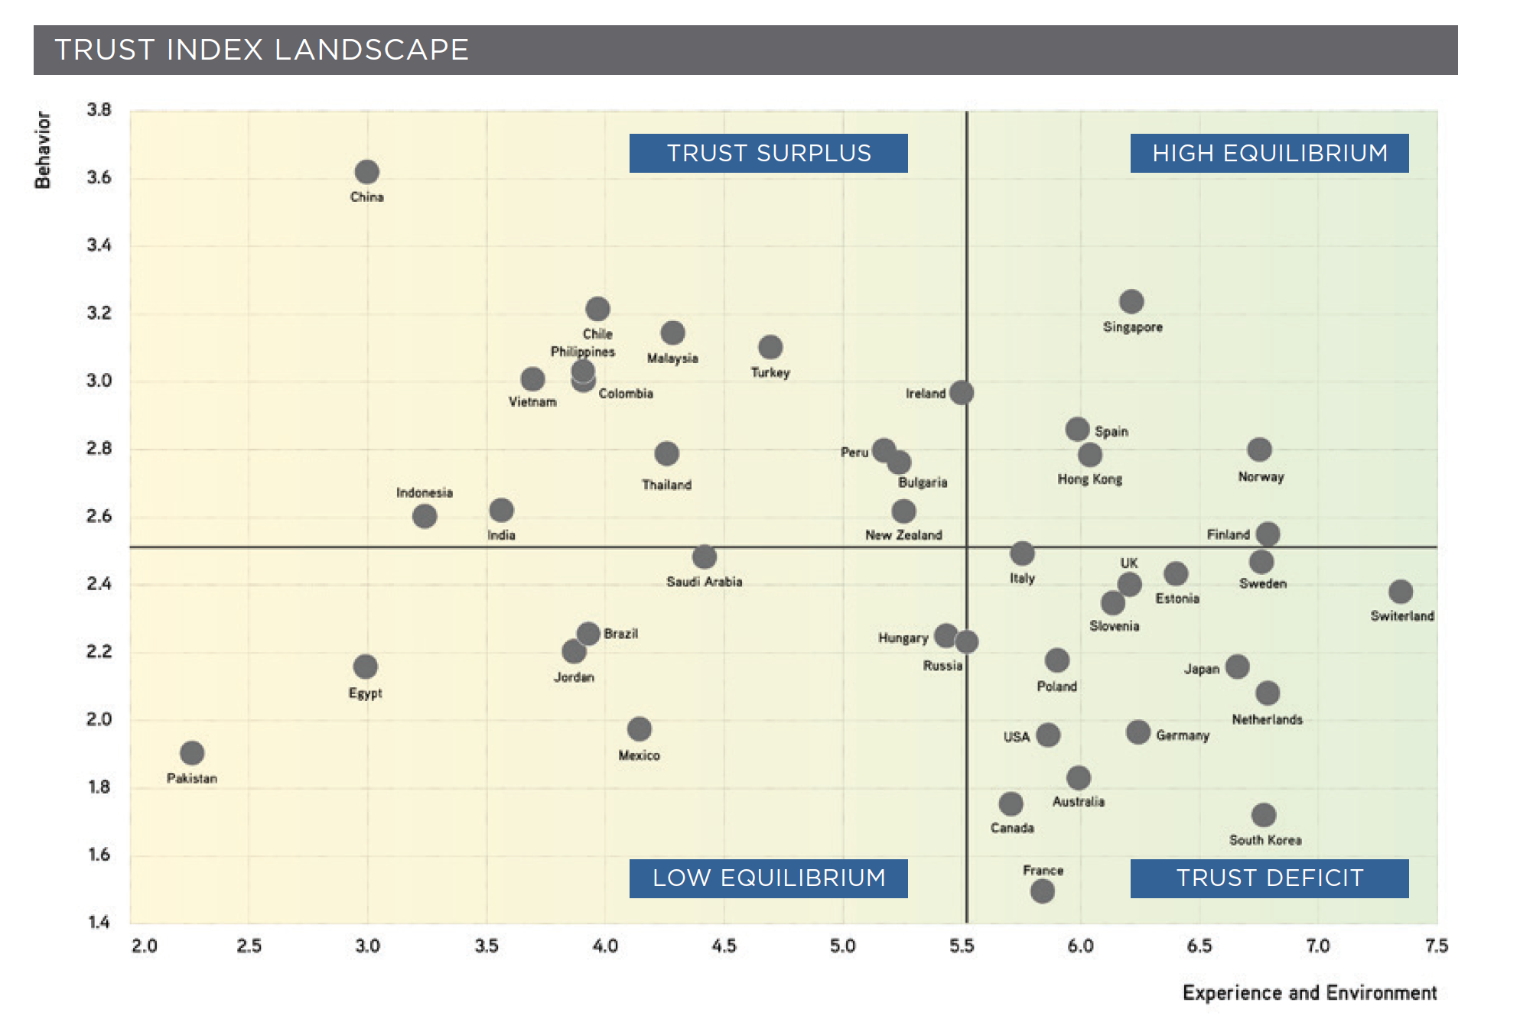
Digital Planet 2017 How competitiveness and trust in digital economies vary across the world, Bhaskar Chakravorti and Ravi Chaturvedi
Notes:
Draw path to high equilibrium

Slide 64
New = Trusted

Slide 65
Digital Planet 2017 How competitiveness and trust in digital economies vary across the world, Bhaskar Chakravorti and Ravi Chaturvedi
Notes:
Countries are moving, in theory, from a trust surplus to a trust deficit as state level experience and environment matures.

Slide 66
Concern over Increases in Trust
How do we move into the High Equilibrium trust quadrant?
We need a new definition of trust in the age of artificial intelligence that moves away from usage and focuses on awareness of the intent or operations of the systems.
Requires Education and Understanding

Slide 67
As it relates to Deep Neural Networks
Deep NN
Gradient Boosted Trees
Predictive Power
Random Forest
Decision Trees
Linear Regression
Interpretability

Slide 68
Concern over Increases in Trust: Work is being Done
Having experience with AI can help create trust (Vyacheslav Polonski, 2018)
Tech companies are issuing transparency reports examples: Twitter and Google
Dietvorst, Simmons, and Massey, (2015), Overcoming Algorithm Aversion:
People Will Use Imperfect Algorithms If They Can (Even Slightly) Modify Them
Small amounts of exposure to AI algos and the ability to modify them helped increase trust.

Slide 69
Concern over Increases in Trust, Pew Research Center Internet and Technology
What will trust in technology look like in the future (1,233 responses):
48% chose the option that trust will be strengthened;
28% believe that trust will stay the same; and
24% predicted that trust will be diminished.
Notes:
Really what people are saying here is that they believe systems will improve which is the common measure of what we mean by trust, but is predicated on a old model that doesn’t include the idea that thing we are working to trust has the ability to learn.

Slide 70
Methods to Enhance the Capability to Distrust: Democratization
Corporate investment in AI trust
CFO David Wehner: Facebook’s 2018 operating expenses may raise by 45 to 60 percent driven by significantly investment in building trust, such as employing larger numbers of humans to review posts and developing artificial intelligence systems to help them
Trust in digital technology will be the internet’s next frontier, for 2018 and beyond, The Conversation, Bhaskar Chakravoti

Slide 71
So How Do We Build Trust in AI?
Interpretable versus Explainable
Notes:
Education and Understanding – Understanding requires explainability

Slide 72
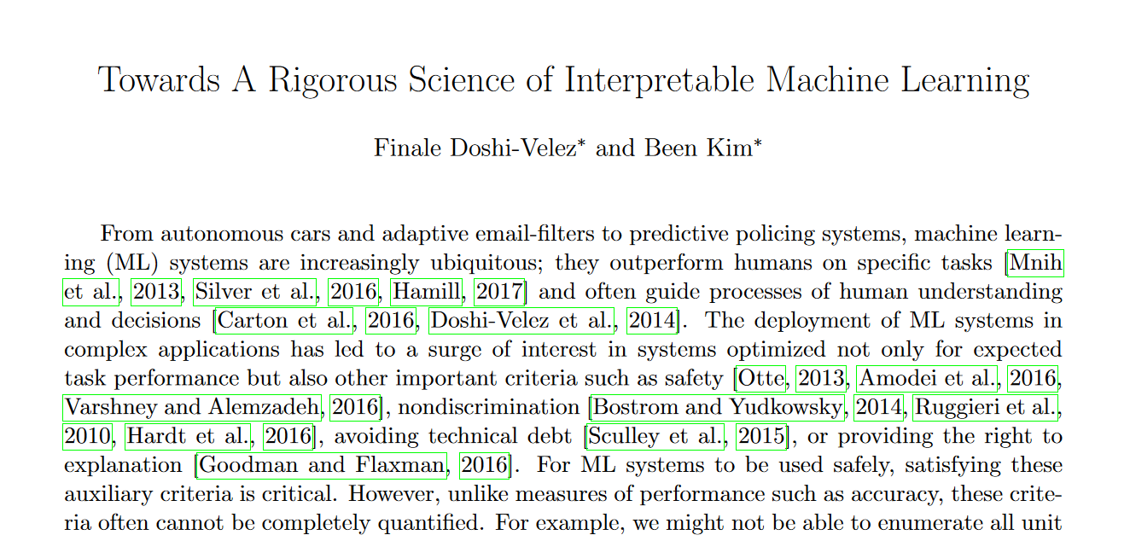

Slide 73
Here auxiliary criteria might mean, non-discrimination or safety in some form.
Finale Doshi-Velez and Been Kim, “Towards a Rigorous Science of Interpretable Machine Learning,” arXiv:1702.08608, 2017, https://arxiv.org/pdf/1702.08608.pdf.

Slide 74
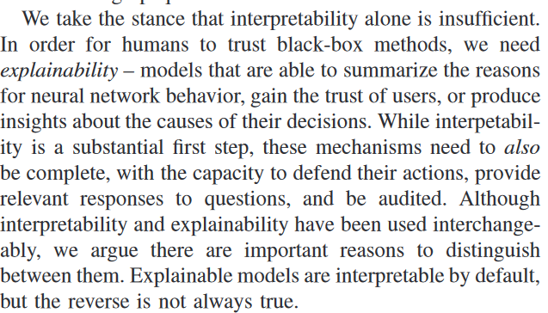
Leilani H. Gilpin et al., “Explaining Explanations: An Approach to Evaluating Inter‐ pretability of Machine Learning,” arXiv:1806.00069, 2018, https://arxiv.org/pdf/1806.00069.pdf.
Notes:
Often cited paper but in conflict with the previous example, however, but encompasses the same general idea.

Slide 75
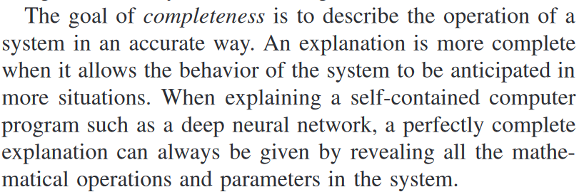
Completeness
Leilani H. Gilpin et al., “Explaining Explanations: An Approach to Evaluating Inter‐ pretability of Machine Learning,” arXiv:1806.00069, 2018, https://arxiv.org/pdf/1806.00069.pdf.

Slide 76
Interpretable
Complexity Constrained Explainable by Design
Explainable (Usually Post Hoc)
Defined by original complexity of the model
NIST - definitions from 2021 - National Institute of Science Technology - link their definitions to cognitive theory: Four Principles of Explainable AI

Slide 77
NIST Four Criteria for “Explainable”
1. Explanation: Systems deliver accompanying evidence or reason(s) for all outputs.
2. Meaningful: Systems provide explanations that are understandable to individual users.
3. Explanation Accuracy: The explanation correctly reflects the system’s process for generating the output.
4. Knowledge Limits: The system only operates under conditions for which it was designed or when the system reaches a sufficient confidence in its output.

Slide 78
Post-Hoc (Visual) Explanations
Reason code generating techniques
LIME – Local Interpretable Model-Agnostic Explanations¹
SHAP – Collation Game Theory² – won a Nobel price – don’t necessary hold up in practice – uses an approximation – EU mathematians kind undercut
Local and Global Visualizations
ALE – Accumulated Local Effect³
ICE – Individual Conditional Expectations⁴
Average behavior plotted alongside individual behavior partial dependence with ICE
Salient Plots
Partial Dependency Plots
Notes:
1 Marco Tulio Ribeiro, Sameer Singh, and Carlos Guestrin, “‘Why Should I Trust You?’: Explaining the Predictions of Any Classifier,” in Proceedings of the 22nd ACM SIGKDD International Conference on Knowledge Discovery and Data Mining, ACM (2016): 1135–1144. https://oreil.ly/2OQyGXx.
2 Scott M. Lundberg and Su-In Lee, “A Unified Approach to Interpreting Model Predictions,” in I. Guyon et al., eds., Advances in Neural Information Processing Systems 30 (Red Hook, NY: Curran Associates, Inc., 2017): 4765–4774. https://oreil.ly/2OWsZYf.
3 Daniel W. Apley, “Visualizing the Effects of Predictor Variables in Black Box Supervised Learning Models,” arXiv:1612.08468, 2016, https://arxiv.org/pdf/1612.08468.pdf.
4 Alex Goldstein et al., “Peeking Inside the Black Box: Visualizing Statistical Learning with Plots of Individual Conditional Expectation,” Journal of Computational and Graphical Statistics 24, no. 1 (2015), https://arxiv.org/pdf/1309.6392.pdf.

Slide 79
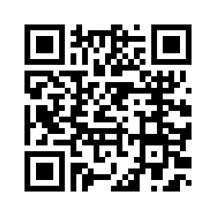
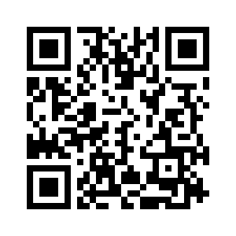
Interpretable but not Complete
ALE: https://www.youtube.com/watch?v=sDDjJRnnHao
LIME/SHAP: https://www.youtube.com/watch?v=jhopjN08lTM

Slide 80
Interpretable Approaches
Constrained Variants of Black Box Models
XNN – Explainable Neural Networks (Bayesian Approaches)
Explainable Boosting Machines - https://interpret.ml/docs/ebm.html
Code Example
Monotonically Constrained Bayesian Rule Lists
Super Sparse Linear Integer Models (SLIMs)
Monotonic GBM – Hall
GA2M – can be edited – can’t trust our training data add – can reach level of performance of traditional models with 2-way interaction effects created the foundation of the explainable field “fit red lines with nn or trees” Microsoft guy
This looks like that deep learning
Scalable Bayesian Rulelist
White Box Models
Tree-based Models
Traditional Linear Models
Certain Clustering Approaches (Kmeans, Hierarchical, etc.)

Slide 81
What makes a model more interpretable: don’t necessary need all of these, need some, think of it as a buffet
Additivity – each of the variables affects the model independently
Sparsity – Limited the volume of information
Bayesian approaches - prior knowledge and accepts uncertainty in outcomes
Constraints – force models to take on explainable forms and obey reality – example Monotonic Gradient Boosting – based on subject matter knowledge
Prototypes – comparison to well-understood standards – other models that are currently in use.
From Patrick Hall – 3.2.2023

Slide 82
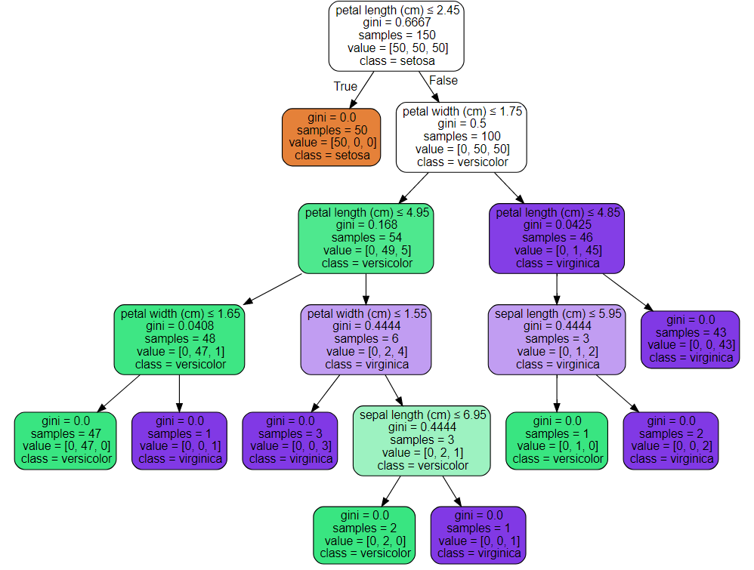
Basics: Decision Tree Graph Example
Root Node
Edges
Internal Nodes
Leaf Nodes

Slide 83
Nobel Laureate Kenneth Arrow noted that trust is “an essential lubricant” that is critical to moving along the interactions of the world
The problem is we need to better understand what trust looks like in the world of AI in order to move forward

Slide 84
Make sure to emphasize the Science part of Data Science
Spend more time defining the questions we are trying to answer to ensure we have the correct data to address the problem.
Ensuring that sources of data are well known and robust enough to generalize to wide populations – if not limit the scope.
Know the limitations of the method
Machine Learning works best when inputs and outputs are well defined and a clear metric for success is established!
Machine learning systems designed to make decisions that are fully automated are very risky. The combination of human intuition and expertise alongside machine learning systems is a better approach.

Slide 85

Methods to Enhance the Capability to Distrust: Democratization
Short Courses on AI BIAS, Sara Hajian, Francesco Bonchi and Carlos Castillo
Trust Project
Use open source tools in model building: Patrick Hall, https://github.com/jphall663/awesome-machine-learning-interpretability
https://poloclub.github.io/cnn-explainer/
SHAP and LIME Video: https://www.youtube.com/watch?v=jhopjN08lTM

Slide 86
What else can go wrong….well

Slide 87
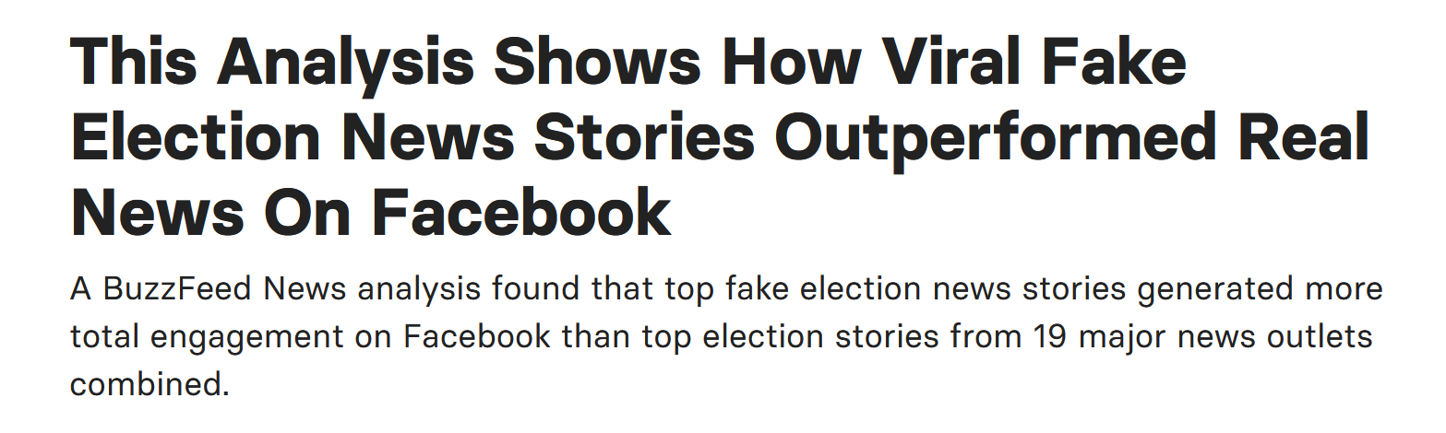
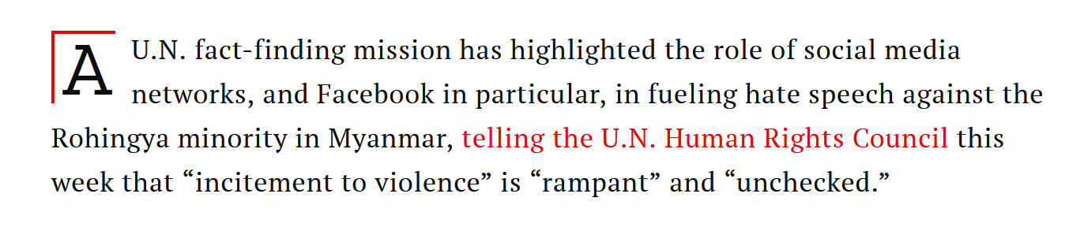
Machine Learning Bias and Social Science Methods: Examples
Facebook
Spread of Fake News
source: https://www.buzzfeednews.com/article/craigsilverman/viral-fake-election-news-outperformed-real-news-on-facebook
Myanmar Genocide
Source: Time.com

Slide 88
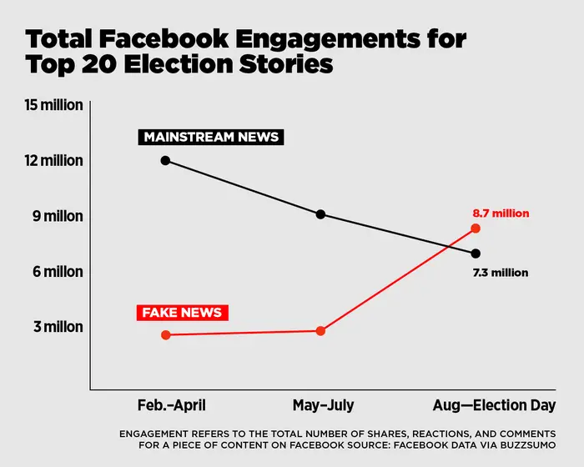

Slide 89
Why?

Slide 90
Machine Learning Bias and Social Science Methods: Examples
Algos gone bad:
Google’s Cloud Natural Language API was launched in 2016. In fall of 2017 Andrew Thompson from Motherboard Inc. experimented with the tool and discovered bias results.
“I’m Christian” had positive results but, “I’m a Jew” and “I’m a gay black woman” resulted in negative results.
Trained on news and social media data

Slide 91
Machine Learning Bias and Social Science Methods: Examples
From Google: “We dedicate a lot of effort to making sure the NLP API avoids bias, but we don’t always get it right. This is an example of one of those times, and we are sorry.” ☹

Slide 92
Machine Learning Bias and Social Science Methods: Examples
Example:
Amazon Recruiting Engine
Used an AI tool to give candidates a score from one to five stars based on resumes and trained on current successful employees.
“They (Amazon) literally wanted it to be an engine where I’m going to give you 100 resumes, and it will spit out the top five, and we’ll hire those.”
The problem was that data was used from 10 years of hiring that was mostly men, so the ML tool systematically scored women lower
Amazon just this year abandoned the project because it couldn’t be proven reliable.

Slide 93
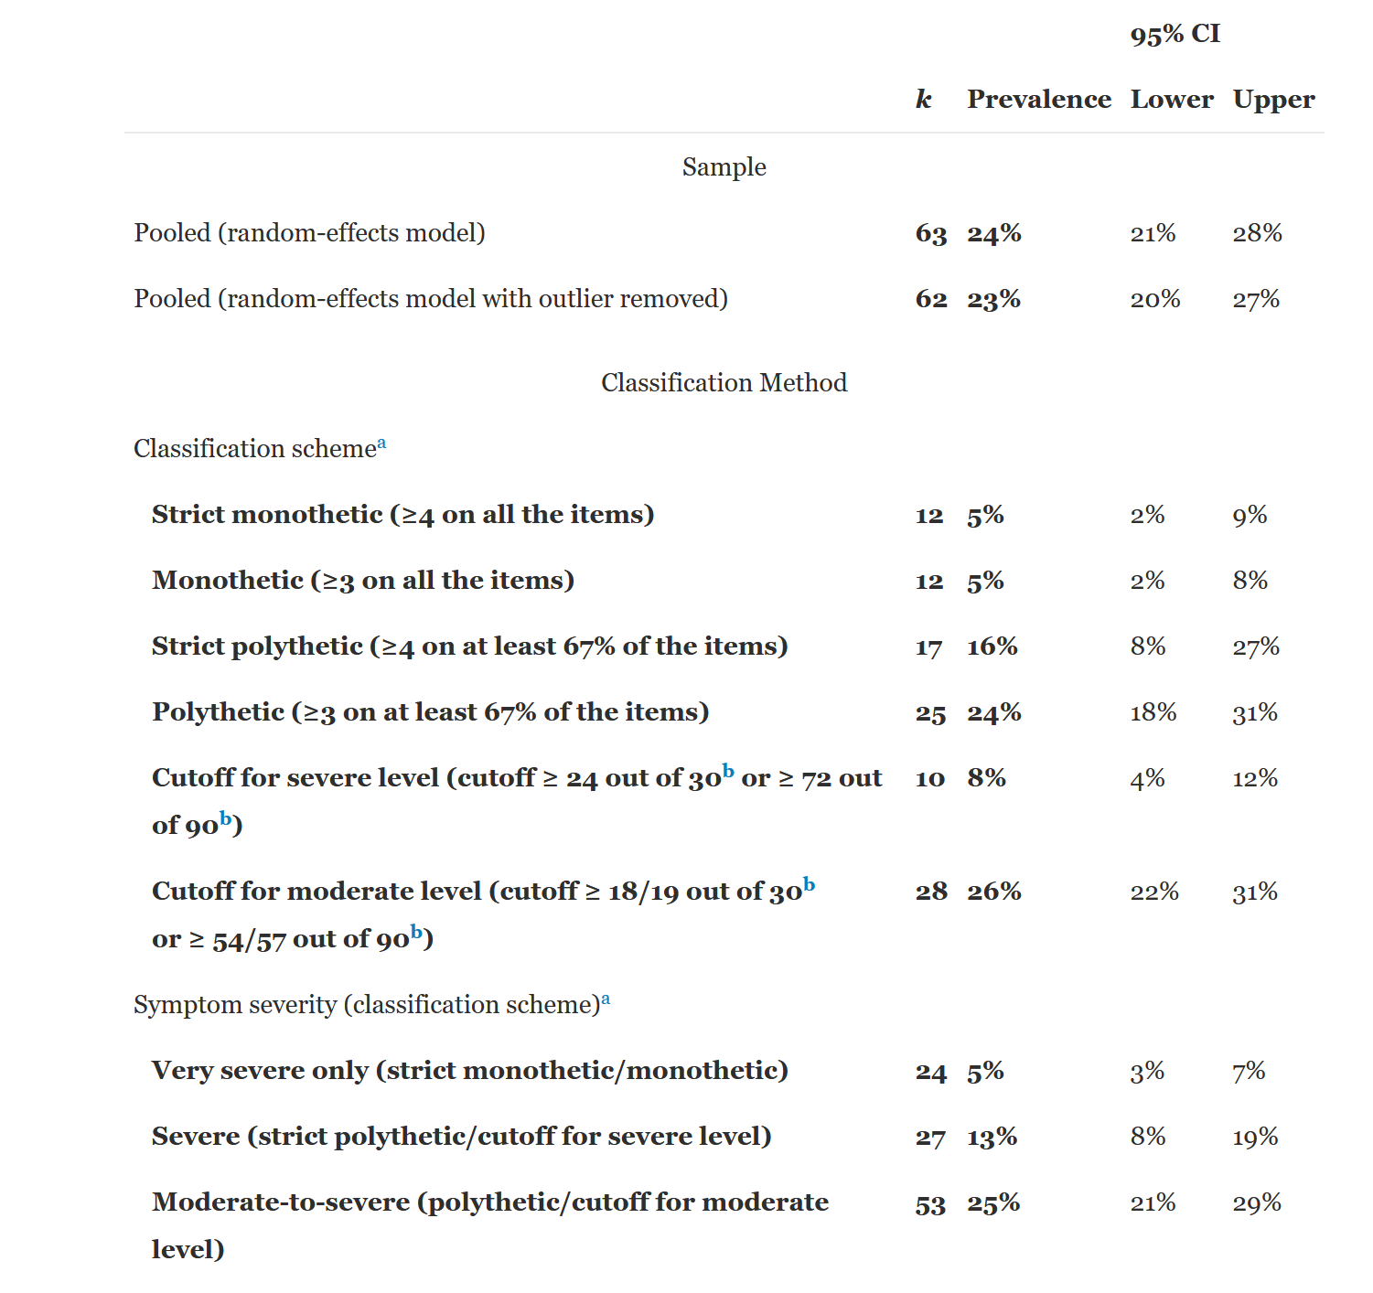
Meta-Analysis
50 Studies
37,798 individuals
Mean age – 24
Gender – 56% Female
July 2020 – 4 Billion user of Social Media
2 billion on Facebook
Very Severe – 200 Million
Severe – 520 Million
Moderate to Severe – 1 billion
Almost half of all social media user could be moderately to severely addicted
Source: Cecilia Cheng, Yan-ching Lau, Linus Chan, Jeremy W. Luk,
Prevalence of social media addiction across 32 nations: Meta-analysis with subgroup analysis of classification schemes and cultural values, Addictive Behaviors, Volume 117, 2021, 106845, ISSN 0306-4603, https://doi.org/10.1016/j.addbeh.2021.106845

Slide 94
In Response, the Data Science is Actively Evolving…it is still early days
The field needed a framework…enter the School of Data Science

Slide 95
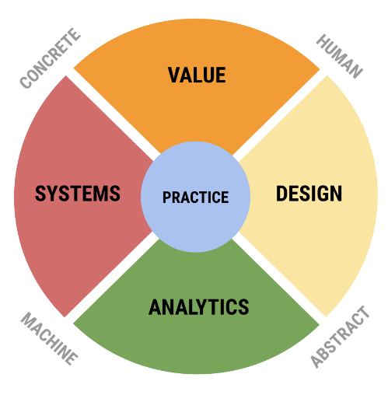
SDS View on Data Science
“Liberal Arts Degree for the Data Age”
UVA SDS needed not just pipeline/process but a conceptual model of field. Rafael Alavardo created this framework of the field.

Slide 96
Value
Combines the traditional discipline of ethics with the professional activities of business planning, policy making, developing motivations for scientific research, and other activities that have a direct impact on people and the planet.
Key tensions: enterprise vs ethics, private interest vs public good (see Plato’s Republic).
Common theme: human value.
Keywords: ethics, justice, wealth, value, social good, motivation, meaning,
Values: responsibility, diversity, inclusion, flourishing, excellence
Ref: Digital Epidemiology

Slide 97
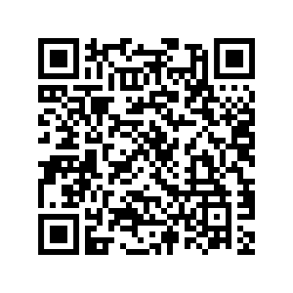
Joy Buolamwimi Facial Recognition

Slide 98
Practice
This area consists of actual activities that brings people together to combine expertise from each of the four areas. It is characterized by data science teams working together and with external parties to develop solutions and projects that are responsible, authentic, effective, and efficient.
Working to develop a dozen or more external concentration that students can pursue – examples neuroscience, digital humanities, forecasting and educational analytics.
This is a non-trivial departure from most current undergraduate models.
Research experiences will be provided throughout the 3 years
Develop pathways into applied graduate programs

Slide 99
Data Literacy = Digital Societal Literacy
Given the expanding influence data has on our lives every student should be exposed to broad Data Education

Slide 100
TU: How would this be implemented practically?
CO: To make it more practical, I’m introducing a concept called the ethical matrix, which is a concept that I’ve borrowed from a moral philosopher, called Ben Mepham, who originally used it in the context of bioethics.
The ethical matrix is a framework to force people to think more broadly. The rows of the matrix includes all the stakeholders that may be impacted by a given algorithm. For example, in the case of the recidivism risk algorithm it will include the judge, it will include the prosecutor, it will include the defendant and it will include the general public
Then, the columns of the matrix are the things that each of these stakeholders actually worry about. For example, the judge is going to worry about freeing someone who is dangerous to the public (a false negative.) Whereas the defendant’s worrying about being punished unnecessarily for something they didn’t or weren’t going to do (a false positive).
The ethical matrix helps lay out all of these competing implications, motivations and considerations and allows data scientists to consider the bigger impact of their designs.
https://www.wired.co.uk/article/data-ai-ethics-hippocratic-oath-cathy-o-neil-weapons-of-math-destruction

Slide 101
Summary
Focus on Problem Solving through Probabilistic Reasoning
Creates a foundation for Market Sector Specialization – Knowledge Economy
Data Literate Society is Required for the Data Age
Maximizes both Human Capital and Signaling Educational Theories

Slide 102
Problem Solving through Probabilistic Reasoning
High level – Two types of reasoning
Type 1 - “…autonomous because their execution is rapid and mandatory when the triggering stimuli are encountered, they do not require much cognitive effort, and they can operate in parallel (Chiesi,Primi, & Morsanyi, 315). ”
People feel they are correct, but they are often wrong and misleading even if the human brain reinforces this reactions as correct, via some automated response mechanism
Type 2 “…processes are relatively slow and computationally expensive, they are available for conscious awareness, serial, and often language based (Chiesi,Primi, & Morsanyi, 315).”
The use of heuristics that facilitate type 1 reasoning increases over time.
Sources: Francesca Chiesi , Caterina Primi & Kinga Morsanyi (2011) Developmental changes in probabilistic reasoning: The role of cognitive capacity, instructions, thinking styles, and relevant knowledge, Thinking & Reasoning, 17:3, 315-350, DOI: 10.1080/13546783.2011.598401

